Slide 1
Skolkovo Innovation Center
Nov 19, 2011

Slide 2
Why Skolkovo?
Normal Technology Life Cycle
Private Equity
IPOs
Large Corporates
Commoditization of Technology
Technology maturity / market acceptance
Entrepreneurs
Mid
Early
Late
Basic Research
Applied Research
VC
Time

Slide 3
Why Skolkovo?
Current Russian Situation
The gap:
Research not linked to market
Little early-stage financing or services
Result: weak commercialization
Private Equity
IPOs
Large Corporates
Commoditization of Technology
Technology maturity / market acceptance
Entrepreneurs
Mid
Early
Late
Basic Research
Applied Research
VC
Time

Slide 4
+ a few more gaps
Practices of sponsored research
Culture of entrepreneurship
Institutional environment
R&D infrastructure
> Low productivity + brain drain

Slide 5
Skolkovo City

Slide 6
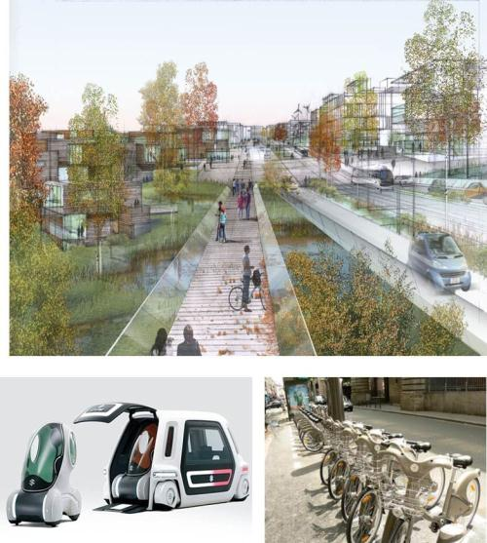
Skolkovo City
Key figures:
400 hectares
10 000 residents
26 000 total employed
6 000 professional jobs
Pedestrian-oriented master plan
Sustainable design, LEED certified
2014 completion date (phase 1)

Slide 7
Special economic regime
No VAT or profit tax for 10 years
14% unified social tax rate (vs. normal 34%)
Refund of customs duties and VAT on imported equipment
Own customs service; simplified migration law

Slide 8
5 thematic areas = Ru modernization priorities
Energy: efficiency, saving, new energy technologies
IT: software, engineering, devices
Biomed: biotech, drugs, devices
Space: telecom, navigation, imaging, life systems
Nuclear: medicine, energy, materials

Slide 9
Key elements of Skolkovo ecosystem
University+
Startups
Corporate R&D centers
VC funds
Moscow School of Management

Slide 10
Technopark supporting startups
Clusters
Skolkovo Institute
Skolkovo Funds
Other
Universities
Coaching & training
Spin-off center
Market assistance
Infrastructure
Corporate services
Funding
External venture funds
Technopark

Slide 11
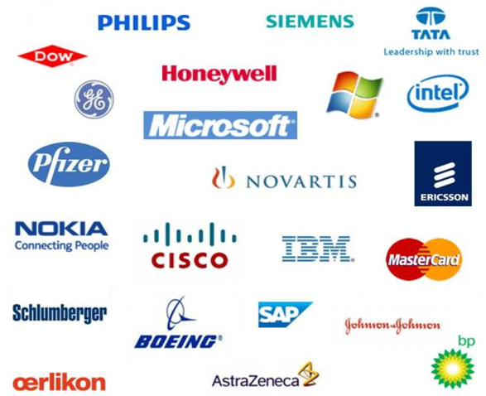
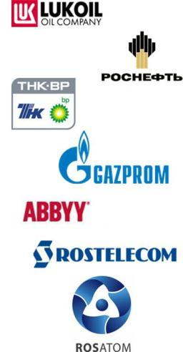
Corporate partners
International companies
Russian companies

Slide 12
The role of corporate partners
Create and operate R&D centers in Skolkovo
Evaluate Skolkovo’s pipeline of promising technologies & advise on strategy
Co-invest in promising Skolkovo start-ups
Offer early commercialization opportunities to Skolkovo startups
Fund research at SkTech

Slide 13
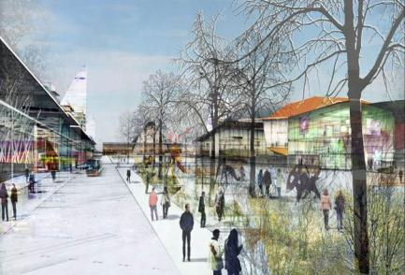
Skolkovo Institute of Science and Technology
World’s first graduate university to fully-integrate research, education, innovation and entrepreneurship
1200 graduate students and 200 faculty by 2018
5 programs, 15 multi-university research centers
Source of expertise in Skolkovo
Source of high-caliber talent
Strategic partner:

Slide 14
Skolkovo Institute: negotiations
MIT faculty
Ru academics
Ru management and legal
Government
Role of faculty in the US
Distribution of faculty time (1/3 spent pitching)
Need of a model
Services contract, quantity v quality bureaucratic control
Gap between capacity to deliver and capacity to assimilate
Quality v speed (political logic)
Interdisciplinarity; complex collaborations
…
Pride
Distance to power
Trust
Cultural bias?
How do we deal with it in Skolkovo?

Slide 15
Engineering system: Skolkovo Environment / Culture

Slide 16
Skolkovo Environment / Culture
Innovation ecosystems: success factors and mechanisms. Engineering systems
Architecture > infrastructure > institutions > institutes > governance
:: frameworks – life is in between
Experience, attractiveness
Communities
Behaviours: types and efficiency/effectiveness
Qualities of the ecosystem
Mindset
Culture
Values
Dynamics
Equilibrium

Slide 18
The solution?
Close the gap with tools for efficient commercialization
Skolkovo “Ecosystem”
Skolkovo Institute
Large Corporates
Commoditization of Technology
Innovation Center
5 clusters
Technopark
Key partners
Technology maturity / market acceptance
Entrepreneurs
VC
Venture Capital
Basic Research
Applied Research
Early
Mid
Late
City Infrastructure
Time

Slide 19
Mission
Skolkovo is a strategic development initiative to:
Develop human capital through world-class research and education
Diversify and grow Russia’s economy through innovation and entrepreneurship
Integrate Russia into global networks of technology and knowledge exchange

Slide 20
Guiding principles
Open, transparent, and fair: essential to attract world-class talent, institutions and businesses
International standards
Maximum private sector participation
Self-sustaining over time
Physical and virtual layers

Slide 21
What Skolkovo is, what Skolkovo is not
We provide financial grants
We are non-profit
We finance and support R&D and early-stage companies
We are a platform for international collaboration in R&D and technology transfer
We support and finance both Russian and international innovation
We are not an investment fund; we do not invest, take equity stakes or board seats
We don’t finance production or advanced commercial activity
We are not a sales agent
We are not limited to Russian technology; our mandate is to enhance 2-way tech transfer

Slide 22
Skolkovo Environment / Culture: open questions
Mixed communities v compartmentalized
Open to external audiences v closed

Slide 23
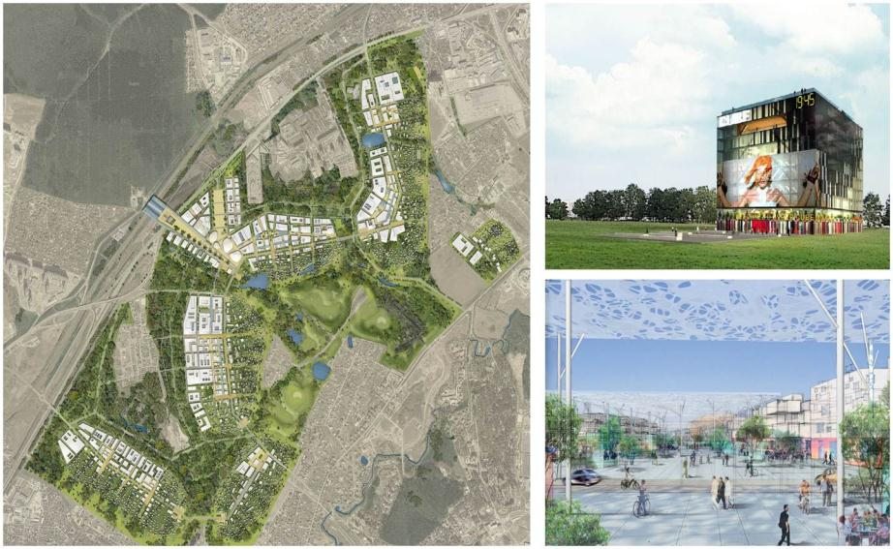
Skolkovo City

