Slide 1
Privacy of profile-based ad targeting
Alexander Smal
and
Ilya Mironov

Slide 2
User-profile targeting
Goal: increase impact of your ads by targeting a group potentially interested in your product.
Examples:
  Social Network
  Profile = user’s personal information + friends
  Search Engine
  Profile = search queries + webpages visited by user

Slide 3
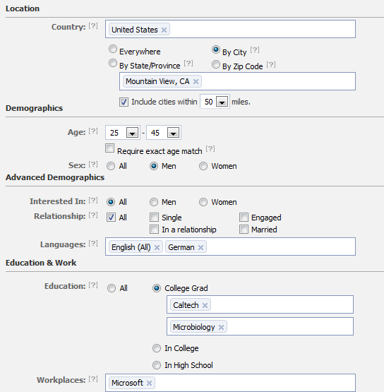
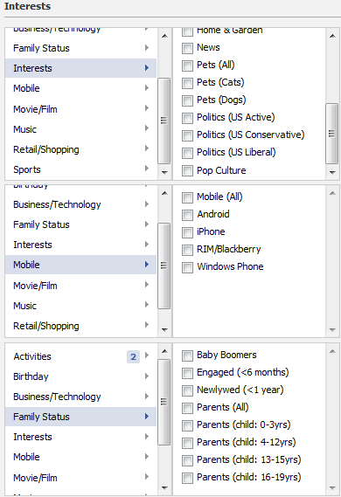
Facebook ad targeting

Slide 4
Characters
Advertising company
Privacy researcher
My system is private!

Slide 5

Simple attack [Korolova’10]
Amazing cat food for $0.99!
Likes fishing
Nice!
- 32 y.o. single man
- Mountain View, CA
….
- has cat
- likes fishing
Targeted ad
noise
Likes fishing
Show
Jon
# of impressions
Eve
Public:
- 32 y.o. single man
- Mountain View, CA
- ….
- has cat
Private:
- likes fishing

Slide 6
Advertising company
Privacy researcher
My system is private!
Unless your targeting is not private, it is not!
How can I target privately?

Slide 7
How to protect information?
Basic idea: add some noise
  Explicitly
  Implicit in the data
    noiseless privacy [BBGLT11]
    natural privacy [BD11]
Two types of explicit noise
  Output perturbation
    Dynamically add noise to answers
  Input perturbation
    Modify the database

Slide 8
Advertising company
Privacy researcher
I like input perturbation better…

Slide 9
Input perturbation
Pro:
  Pan-private (not storing initial data)
  Do it once
  Simpler architecture

Slide 10
Advertising company
Privacy researcher
I like input perturbation better…
Signal is sparse and non-random

Slide 11
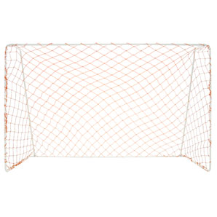
Adding noise
Two main difficulties in adding noise:
Sparse profiles
Dependent bits
1 | 0 | 0 | 0 | 1 | 0 | 0 | 0 | 1 | 0
0 | 0 | 0 | 0 | 0 | 0 | 0 | 0 | 1 | 1
0 | 0 | 0 | 1 | 0 | 0 | 0 | 0 | 0 | 1
0 | 0 | 0 | 1 | 0 | 0 | 1 | 0 | 0 | 0
0 | 1 | 1 | 0 | 0 | 0 | 0 | 0 | 0 | 1
0 | 0 | 0 | 0 | 1 | 0 | 0 | 1 | 0 | 0
0 | 0 | 1 | 0 | 0 | 0 | 0 | 1 | 1 | 0
0 | 0 | 0 | 0 | 0 | 0 | 0 | 1 | 0 | 1
1 | 0 | 1 | 0 | 0 | 0 | 0 | 0 | 0 | 0
0 | 1 | 0 | 1 | 0 | 1 | 0 | 0 | 0 | 0
1 | 0 | 0 | 1 | 1 | 1 | 0 | 1 | 0 | 0
0 | 1 | 0 | 0 | 0 | 0 | 0 | 0 | 1 | 1
1 | 0 | 0 | 0 | 0 | 0 | 0 | 0 | 1 | 0
1 | 0 | 0 | 1 | 1 | 1 | 1 | 0 | 0 | 0
0 | 1 | 1 | 0 | 0 | 0 | 0 | 0 | 1 | 1
1 | 0 | 0 | 0 | 1 | 0 | 0 | 1 | 0 | 0
0 | 1 | 1 | 1 | 1 | 1 | 0 | 1 | 1 | 1
0 | 1 | 0 | 0 | 0 | 0 | 0 | 1 | 0 | 0
1 | 0 | 1 | 1 | 1 | 1 | 0 | 0 | 0 | 0
0 | 1 | 0 | 0 | 0 | 0 | 0 | 1 | 0 | 1
1 | 1 | 1 | 1 | 1 | 0 | 0 | 1 | 0 | 1
differential privacy
“Smart noise”
deniability

Slide 12
Advertising company
Privacy researcher
I like input perturbation better…
Signal is sparse and non-random
Let’s shoot for deniability, and add “smart noise”!

Slide 13
“Smart noise”
Consider two extreme cases
  All bits are independent
  independent noise
  All bits are correlated with correlation coefficient 1
    correlated noise
“Smart noise” hypothesis:
“If we know the exact model we can add right noise”
Aha!

Slide 14
Dependent bits in real data
Netflix prize competition data
  ~480k users, ~18k movies, ~100m ratings
Estimate movie-to-movie correlation
  Fact that a user rated a movie
Visualize graph of correlations
  Edge – correlation with correlation coefficient > 0.5

Slide 15
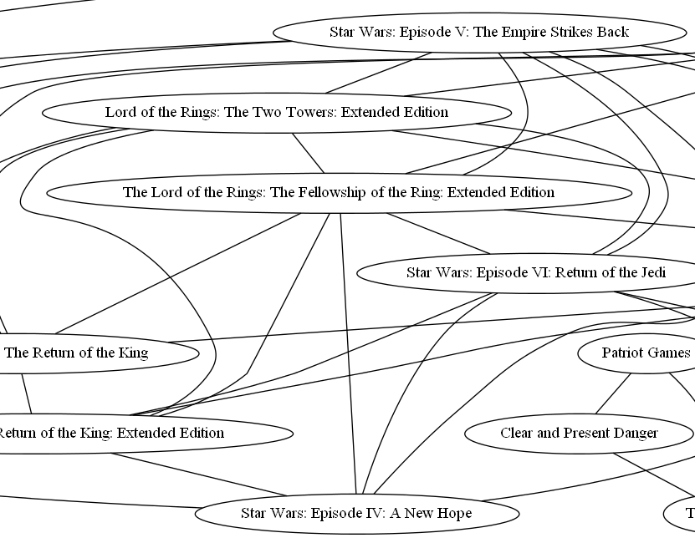
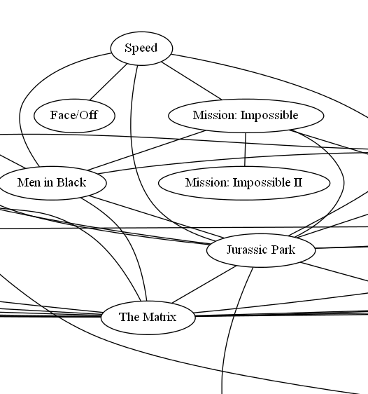
Netflix movie correlations

Slide 16
Let’s shoot for deniability, and add “smart noise”!
Advertising company
Privacy researcher
Let’s construct models where “smart noise” fails

Slide 17



How can “smart noise” fail?
large
large = relative distance $Ω(1)$

Slide 18




Models of user profiles
$M$ hidden bits
1 | 0 | 1 | … | 0 | 1
$M$ hidden independent bits
$N$ public bits
Public bits are some functions of hidden bits
$$f$$
$N$ public bits
1 | 1 | 0 | 1 | … | 0 | 1 | 0 | 1
Are users well separated?

Slide 19


Error-correcting codes
Constant relative distance
Unique decoding
Explicit, efficient

Slide 20
Advertising company
See — unless the noise is >25%, no privacy
Privacy researcher
But this model is unrealistic!
Let me see what I can do with monotone functions…

Slide 21
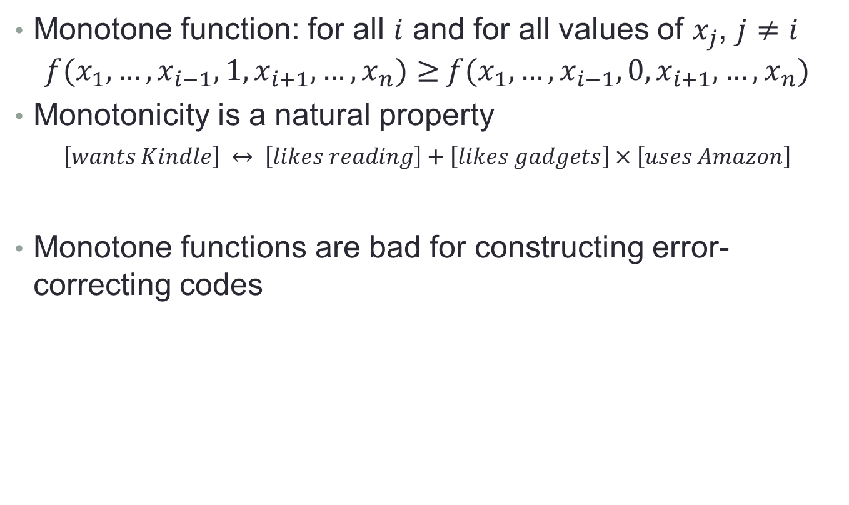
Monotone functions
Monotone function: for all $i$ and for all values of $x_{j}$, $j≠i$
${f(x}_{1},…,x_{i−1},1,x_{i+1},…,x_{n})≥{ f(x}_{1},…,x_{i−1},0,x_{i+1},…,x_{n})$
Monotonicity is a natural property
$$\left[wants Kindle\right] ↔ \left[likes reading\right]+\left[likes gadgets\right]×\left[uses Amazon\right]$$
Monotone functions are bad for constructing error-correcting codes

Slide 22
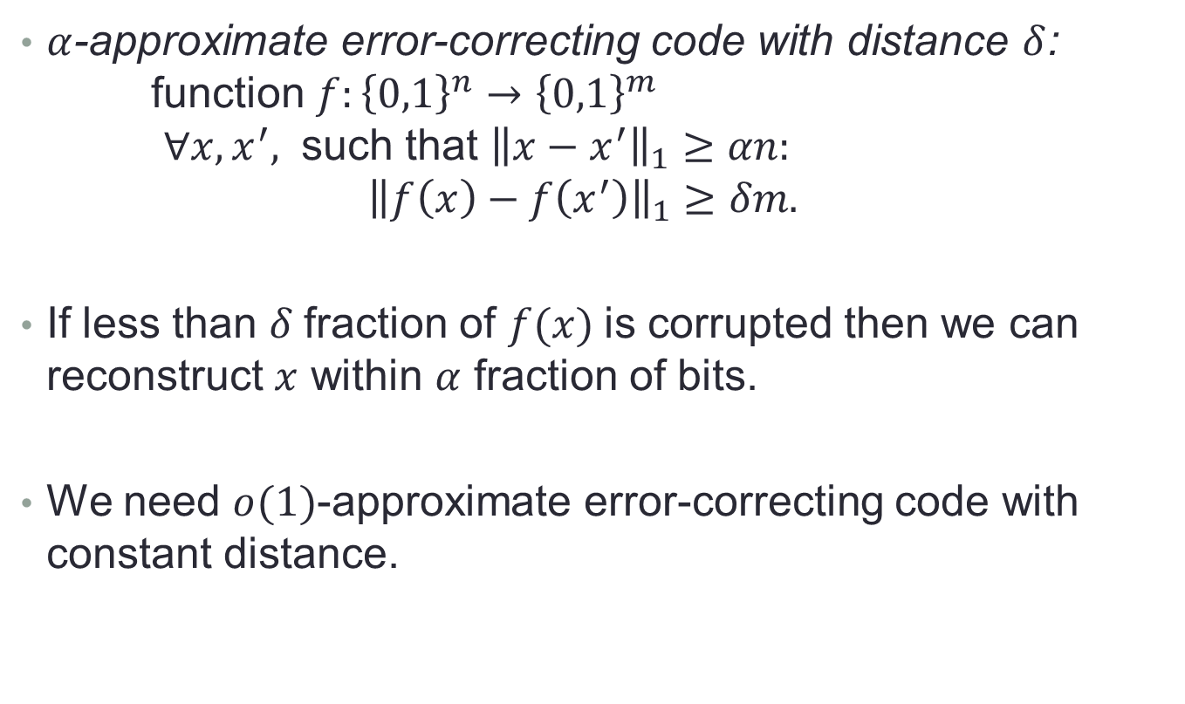
Approximate error-correcting codes
$α$-approximate error-correcting code with distance $δ$:
function $f:{\left\{0,1\right\}}^{n}→{\left\{0,1\right\}}^{m}$
$∀x,x^{′},$ such that ${\left\|x−x^{′}\right\|}_{1}≥αn:$
${\left\|f\left(x\right)−f\left(x^{′}\right)\right\|}_{1}≥δm.$
If less than $δ$fraction of $f(x)$is corrupted then we can reconstruct $x$ within $α$ fraction of bits.
We need $o(1)$-approximate error-correcting code with constant distance.
blatant non-privacy

Slide 23

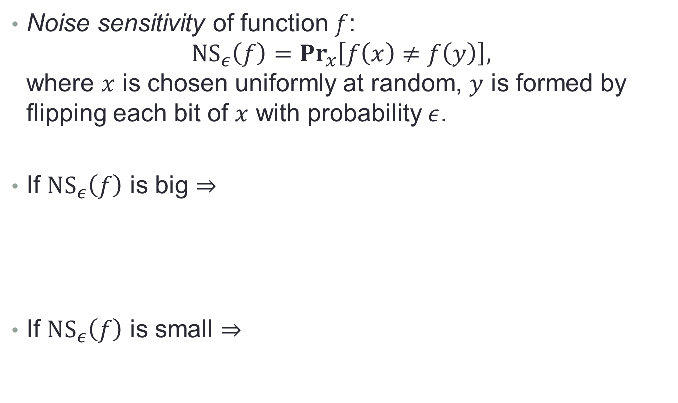



Noise sensitivity
Noise sensitivity of function $f$:
$NS_{ε}\left(f\right)=Pr_{x}\left[f\left(x\right)≠f\left(y\right)\right],$
where $x$ is chosen uniformly at random, $y$ is formed by flipping each bit of $x$ with probability $ε$.
If $NS_{ε}\left(f\right)$ is big $⇒$
If $NS_{ε}\left(f\right)$ is small $⇒$
$M$ hidden bits
1 | 1 | 1 | … | 0 | 0
1 | 0 | 1 | … | 0 | 1
$$f$$
$N$ public bits
1 | 1 | 0 | 1 | … | 0 | 1 | 0 | 1
1 | 0 | 0 | 0 | … | 1 | 1 | 1 | 1
$M$ hidden bits
1 | 1 | 1 | … | 0 | 0
1 | 0 | 1 | … | 0 | 1
$$f$$
$N$ public bits
1 | 1 | 1 | 1 | … | 0 | 0 | 0 | 1
1 | 1 | 0 | 1 | … | 0 | 1 | 0 | 1

Slide 24
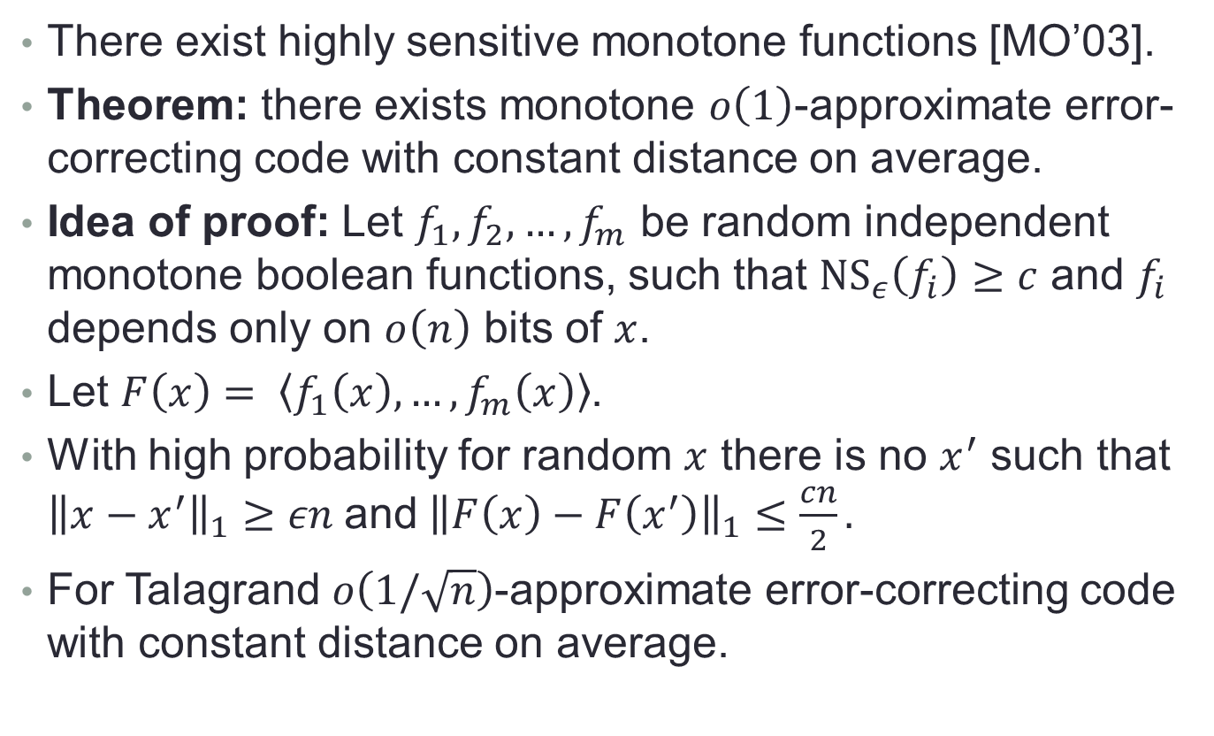
Monotone functions
There exist highly sensitive monotone functions [MO’03].
Theorem: there exists monotone $o\left(1\right)$-approximate error-correcting code with constant distance on average.
Idea of proof: Let $f_{1},f_{2},…,f_{m}$ be random independent monotone boolean functions, such that ${NS}_{ε}\left(f_{i}\right)≥c$ and $f_{i}$ depends only on $o\left(n\right)$ bits of $x$.
Let $F\left(x\right)= \left\langle f_{1}\left(x\right),…,f_{m}\left(x\right)\right\rangle$.
With high probability for random $x$ there is no $x^{′}$ such that ${\left\|x−x^{′}\right\|}_{1}≥εn$and${\left\|F\left(x\right)−F\left(x^{′}\right)\right\|}_{1}≤\frac{cn}{2}.$
For Talagrand $o\left(1/\sqrt{n}\right)$-approximate error-correcting code with constant distance on average.

Slide 25
Advertising company
Privacy researcher
If the model is monotone, blatant non-privacy is still possible
Hmmm. Does smart noise ever work?

Slide 26
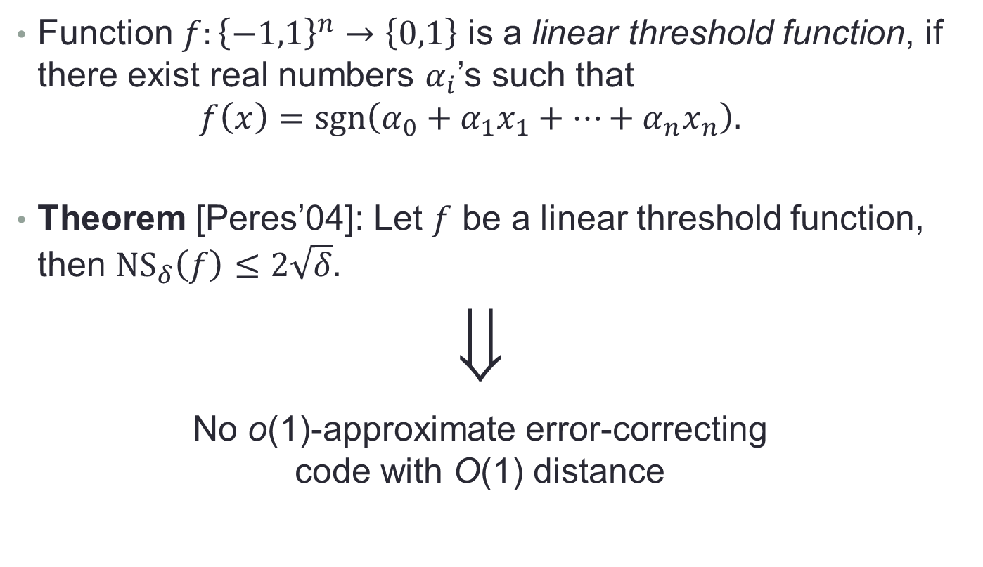
Linear threshold model
Function $f:{\left\{−1,1\right\}}^{n}→\left\{0,1\right\}$ is a linear threshold function, if there exist real numbers $α_{i}$’s such that
$f\left(x\right)=sgn\left(α_{0}+α_{1}x_{1}+⋯+α_{n}x_{n}\right).$
Theorem [Peres’04]: Let $f$ be a linear threshold function, then ${NS}_{δ}\left(f\right)≤2\sqrt{δ}.$
⇓
No o(1)-approximate error-correcting
code with O(1) distance

Slide 27
Conclusion
Two separate issues with input perturbation:
  Sparseness
  Dependencies
“Smart noise” hypothesis:
  Even for a publicly known, relatively simple model, constant corruption of profiles may lead to blatant non-privacy.
Connection between noise sensitivity of boolean functions and privacy
Open questions:
  Linear threshold privacy-preserving mechanism?
  Existence of interactive privacy-preserving solutions?
  Arbitrary
  Monotone
  Linear threshold
fallacy

Slide 28
Thank for your attention!
Special thanks for Cynthia Dwork, Moises Goldszmidt, Parikshit Gopalan, Frank McSherry, Moni Naor, Kunal Talwar, and Sergey Yekhanin.

Slide 29

Events ${[f}_{i}\left(x\right)≠f_{i}\left(y\right)]$ and ${[f}_{j}\left(x\right)≠f_{j}\left(y\right)]$ are independent for random $x$, $y=N_{ε}\left(x\right)$, $i$ and $j$.
Chernoff bounds: $Pr_{x,y=N_{ε}\left(x\right)}\left[\sum_{i=1}^{m}{\left|f_{i}\left(x\right)−f_{i}\left(y\right)\right|}<\frac{mc}{2}\right]<e^{−\frac{mc}{8}}$.

