Slide 1
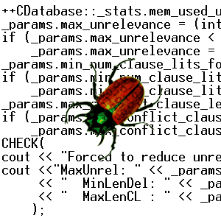
Software Verification
Natasha Sharygina
The University of Lugano,
Carnegie Mellon University
Computer Science Club, Steklov Math Institute
Lecture 1

Slide 2
Outline
Lecture 1:
Motivation
Model Checking in a Nutshell
Software Model Checking
  SAT-based approach
Lecture 2:
Verification of Evolving Systems (Component Substitutability Approach)

Slide 3
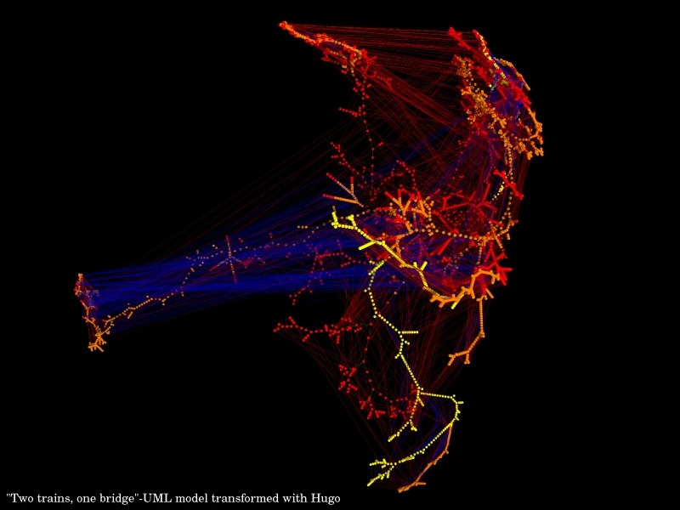
Guess what this is!
Bug Catching: Automated Program Analysis
Informatics Department
The University of Lugano
Professor Natasha Sharygina

Slide 4
Two trains, one bridge – model transformed with a simulation tool, Hugo
Bug Catching: Automated Program Analysis
Informatics Department
The University of Lugano
Professor Natasha Sharygina

Slide 5
Motivation
More and more complex computer systems
  exploding testing costs
Increased functionality
  dependability concerns
Increased dependability
  reliability/security concerns

Slide 6
System Reliability
Bugs are unacceptable in safety/security-critical applications: mission control systems, medical devices, banking software, etc.
Bugs are expensive: earlier we catch them, the better: e.g., Buffer overflows in MS Windows
Automation is key to improve time-to-market

Slide 7
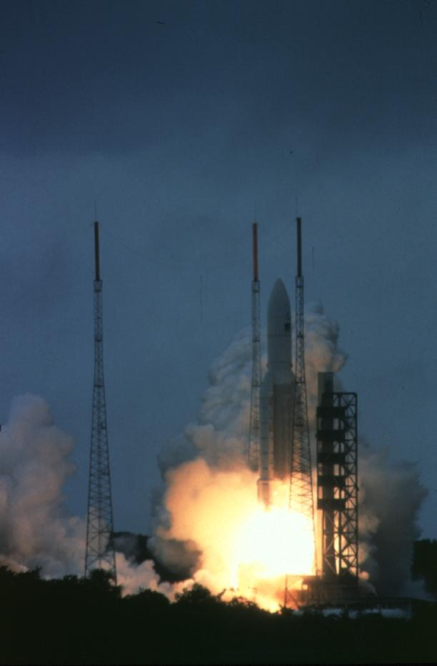
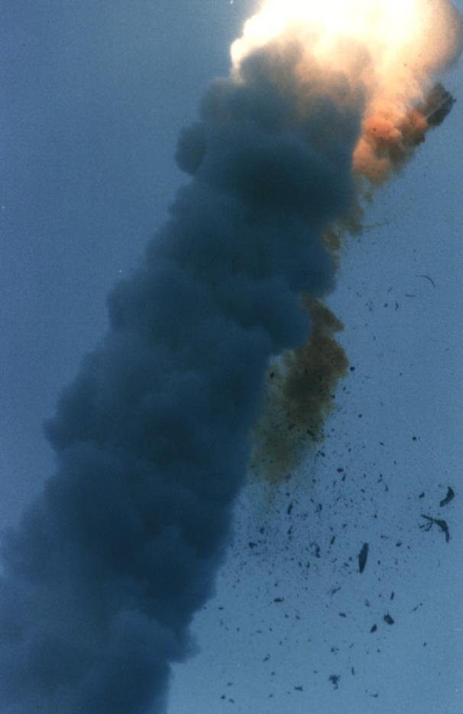
French Guyana, June 4, 1996
$600 million software failure

Slide 8
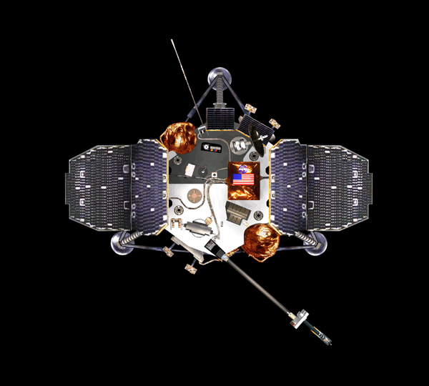
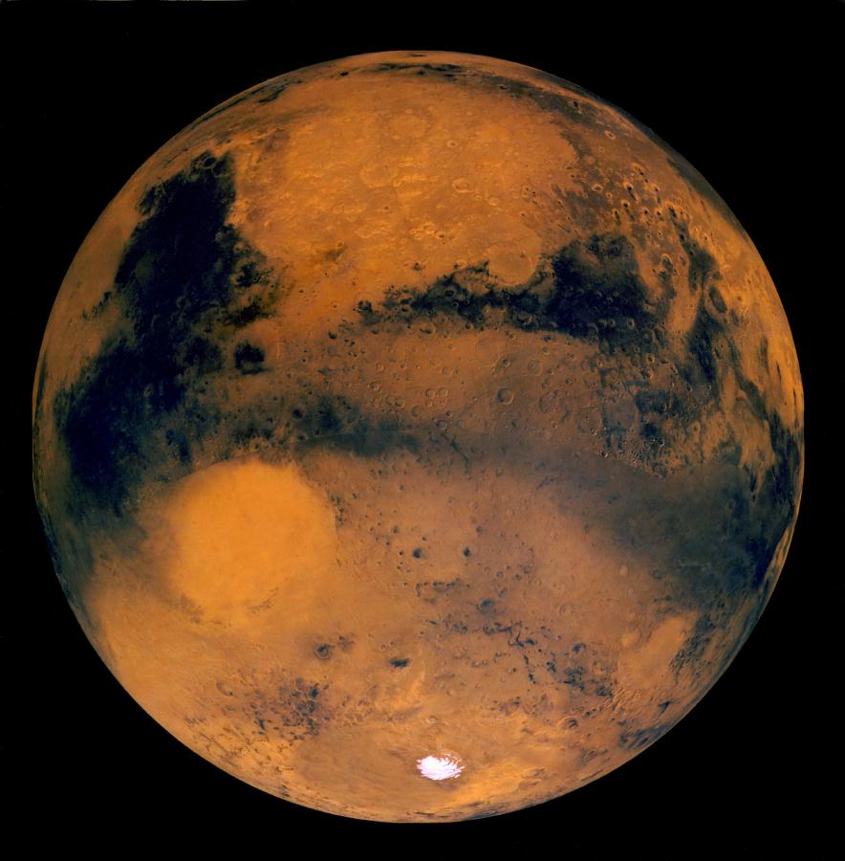
Mars, December 3, 1999
Crashed due to uninitialized variable

Slide 9
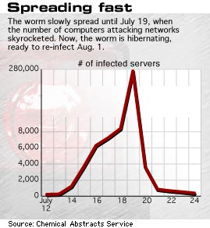
Microsoft Code Red:
Buffer overrun
Estimated cost $2.6 billion

Slide 10
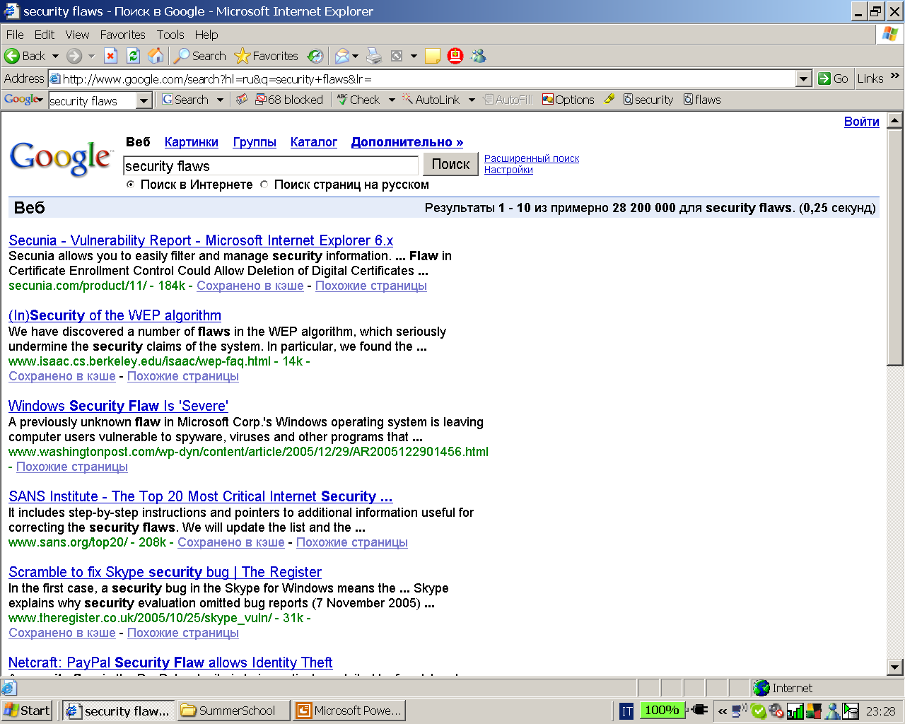

Slide 11
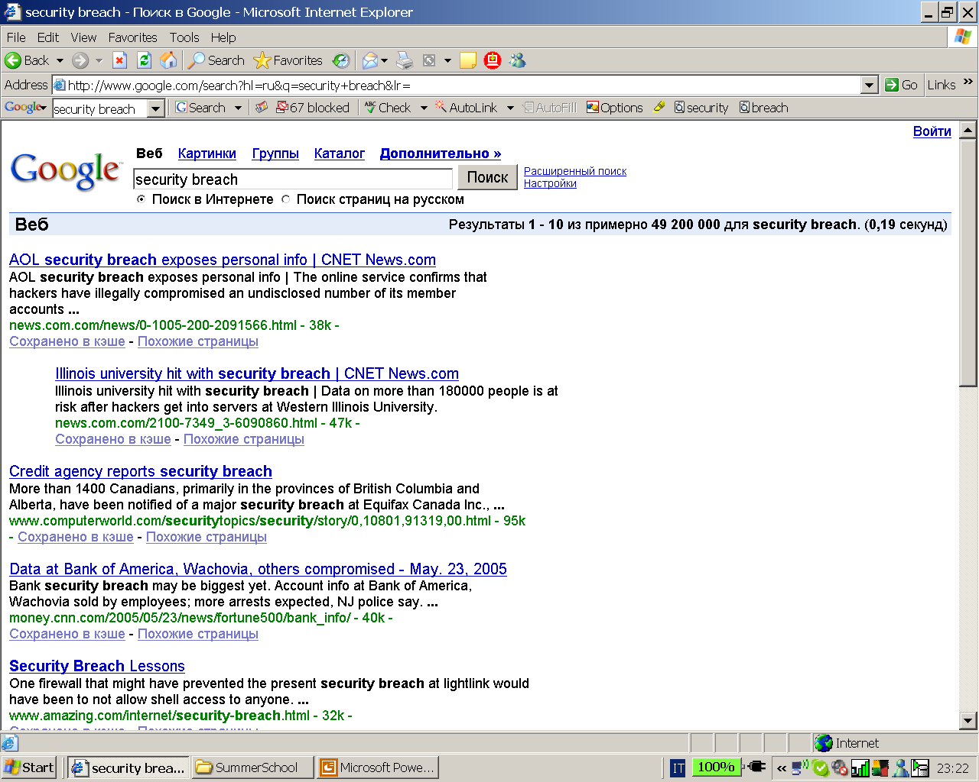

Slide 12
Traditional Approaches
Testing: Run the system on select inputs
Simulation: Simulate a model of the system on select (often symbolic) inputs
Code review and auditing

Slide 13
What are the Problems?
not exhaustive (missed behaviors)
not all are automated (manual reviews, manual testing)
do not scale (large programs are hard to handle)
no guarantee of results (no mathematical proofs)
concurrency problems (non-determinism)

Slide 14
What is Formal Verification?
Build a mathematical model of the system:
  what are possible behaviors?
Write correctness requirement in a specification language:
  what are desirable behaviors?
Analysis: (Automatically) check that model satisfies specification
Notes:
Check => proof system to decide when a property holds

Slide 15
What is Formal Verification (2)?
Formal - Correctness claim is a precise mathematical statement
Verification - Analysis either proves or disproves the correctness claim
Notes:
Check => proof system to decide when a property holds

Slide 16
Algorithmic Analysis by Model Checking
Analysis is performed by an algorithm (tool)
Analysis gives counterexamples for debugging
Typically requires exhaustive search of state-space
Limited by high computational complexity

Slide 17
Temporal Logic Model Checking
[Clarke,Emerson 81][Queille,Sifakis 82]
M |= P
“implementation” (system model)
“specification” (system property)
“satisfies”, “implements”, “refines” (satisfaction relation)

Slide 18
Temporal Logic Model Checking
more detailed
M |= P
more abstract
“implementation” (system model)
“specification” (system property)
“satisfies”, “implements”, “refines”, “confirms”, (satisfaction relation)

Slide 19
Temporal Logic Model Checking
M |= P
system model
system property
satisfaction relation

Slide 20
Decisions when choosing a system model:
variable-based vs. event-based
interleaving vs. true concurrency
synchronous vs. asynchronous interaction
clocked vs. speed-independent progress
etc.

Slide 21
Characteristics of system models
which favor model checking over other verification techniques:
ongoing input/output behavior (not: single input, single result)
concurrency
(not: single control flow)
control intensive
(not: lots of data manipulation)

Slide 22
Decisions when choosing a system model:
While the choice of system model is important for ease of modeling in a given situation,
the only thing that is important for model checking is that the system model can be translated into some form of state-transition graph.

Slide 23
Finite State Machine (FSM)
Specify state-transition behavior
Transitions depict observable behavior
unlock
unlock
lock
ERROR
lock
Acceptable sequences of acquiring and releasing a lock

Slide 24
High-level View
Linux
Kernel
(C)
Conformance
Check
Spec
(FSM)

Slide 25
High-level View
Model Checking
Linux
Kernel
(C)
Finite State
Model
(FSM)
Spec
(FSM)
By Construction

Slide 26
Low-level View
State-transition graph
Q set of states
I set of initial states
P set of atomic observation
T ⊆ Q × Q transition relation
[ ]: Q → 2^{P} observation function

Slide 27
q₁
a
a,b
b
q₂
q₃
Run: q₁ → q₃ → q₁ → q₃ → q₁ → state sequence
Trace: a → b → a → b → a → observation sequence

Slide 28
Model of Computation
a b
a b
b c
c
a b
c
c
b c
c
State Transition Graph
Infinite Computation Tree
Unwind State Graph to obtain Infinite Tree.
A trace is an infinite sequence of state observations

Slide 29
Semantics
a b
a b
b c
c
a b
c
c
b c
c
State Transition Graph
Infinite Computation Tree
The semantics of a FSM is a set of traces

Slide 30
Where is the model?
Need to extract automatically
Easier to construct from hardware
Fundamental challenge for software
Linux Kernel
~1000,000 LOC
Recursion and data structures
Pointers and Dynamic memory
Processes and threads
Finite State
Model

Slide 31
Mutual-exclusion protocol
||
loop
out: x1 := 1; last := 1
req: await x2 = 0 or last = 2
in: x1 := 0
end loop.
loop
out: x2 := 1; last := 2
req: await x1 = 0 or last = 1
in: x2 := 0
end loop.
P1
P2

Slide 32
oo001
ro101
or012
io101
rr112
pc1: {o,r,i} pc2: {o,r,i} x1: {0,1} x2: {0,1} last: {1,2}
ir112
3⋅3⋅2⋅2⋅2 = 72 states

Slide 33
State space blow up
The translation from a system description to a state-transition graph usually involves an exponential blow-up !!!
e.g., n boolean variables ⇒ 2^{n} states
This is called the “state-explosion problem.”

Slide 34
Temporal Logic Model Checking
M |= P
system model
system property
satisfaction relation

Slide 35
Decisions when choosing system properties:
operational vs. declarative: automata vs. logic
may vs. must: branching vs. linear time
prohibiting bad vs. desiring good behavior: safety vs. liveness

Slide 36
System Properties/Specifications
- Atomic propositions: properties of states
- (Linear) Temporal Logic Specifications: properties of traces.

Slide 37
Specification (Property)
Examples: Safety (mutual exclusion): no two processes can be at the critical section at the same time
        Liveness (absence of starvation): every request will be
        eventually granted
Linear Time Logic (LTL) [Pnueli 77]: logic of temporal sequences.
next (α): α holds in the next state
eventually(γ): γ holds eventually
always(λ): λ holds from now on
α until β: α holds until β holds
α
γ
λ
λ
λ
λ
α
α
β

Slide 38
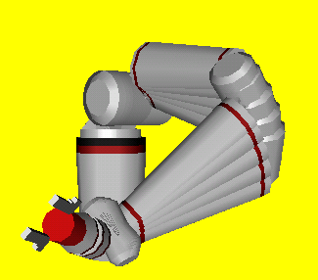
v_{EEF}

Slide 39
Examples of the Robot Control Properties
  Configuration Validity Check:
  If an instance of EndEffector is in the “FollowingDesiredTrajectory” state, then the instance of the corresponding Arm class is in the ‘Valid” state
  Always((ee_reference=1) ->(arm_status=1)
  Control Termination: Eventually the robot control terminates
  EventuallyAlways(abort_var=1)

Slide 40
What is “satisfy”?
M satisfies S if all the reachable states satisfy P
Different Algorithms to check if M |= P.
- Explicit State Space Exploration
For example: Invariant checking Algorithm.
Start at the initial states and explore the states of M
using DFS or BFS.
In any state, if P is violated then print an “error trace”.
If all reachable states have been visited then say “yes”.

Slide 41
State Space Explosion
Problem: Size of the state graph can be exponential in size
of the program (both in the number of the
program variables and the number of program
components)
M = M₁ || … || M_{n}
If each M_{i} has just 2 local states, potentially 2^{n} global states
Research Directions: State space reduction

Slide 42
Abstractions
They are one of the most useful ways to fight the state explosion problem
They should preserve properties of interest: properties that hold for the abstract model should hold for the concrete model
Abstractions should be constructed directly from
the program

Slide 43
Data Abstraction
Given a program P with variables x₁,...x_{n} , each over
domain D, the concrete model of P is defined over states
(d₁,...,d_{n}) ∈ D×...×D
Choosing
Abstract domain A
Abstraction mapping (surjection) h: D → A
we get an abstract model over abstract states (a₁,...,a_{n}) ∈ A×...×A
Notes:
Actually each variable x_{i} is over a domain D_{i} and we choose an abstract domain A_{i} for it.

Slide 44
Example
Given a program P with variable x over the integers
Abstraction 1:
A₁ = { a–, a₀, a₊ }
a₊ if d>0
h₁(d) = a₀ if d=0
a– if d<0
Abstraction 2:
A₂ = { a_{even}, a_{odd} }
h₂(d) = if even( |d| ) then a_{even} else a_{odd}

Slide 45
Existential Abstraction
A
M < A
h
h
h
M

Slide 46
Existential Abstraction
1
[1]
a
b
a
b
[2,3]
2
3
c
d
e
f
c
d
e
f
[4,5]
[6,7]
4
5
6
7
M
A

Slide 47
Existential Abstraction
Every trace of M is a trace of A
  A over-approximates what M can do
  (Preserves safety properties!): A satisfies φ ⇒ M satisfies φ
Some traces of A may not be traces of M
  May yield spurious counterexamples - < a, e >
Eliminated via abstraction refinement
  Splitting some clusters in smaller ones
  Refinement can be automated

Slide 48
Original Abstraction
1
[1]
a
b
a
b
[2,3]
2
3
c
d
e
f
c
d
e
f
[4,5]
[6,7]
4
5
6
7
M
A

Slide 49
Refined Abstraction
1
[1]
a
b
a
b
[2]
[3]
2
3
c
d
e
f
c
d
e
f
[4,5]
[6,7]
4
5
6
7
M
A

Slide 50

Predicate Abstraction
[Graf/Saïdi 97]
Idea: Only keep track of predicates on data
Abstraction function:

Slide 51
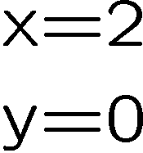
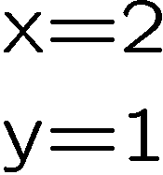
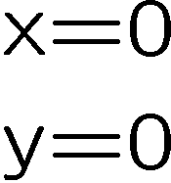



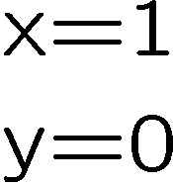
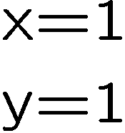
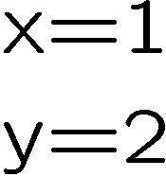

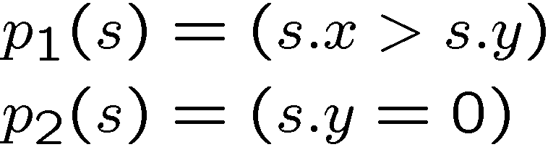
Predicate Abstraction
Concrete States:
Predicates:
Abstract transitions?

Slide 52
Predicate Abstraction
✓
✓
Abstract Transitions:
✓
Property:
Property holds. Ok.

Slide 53

Predicate Abstraction
✓
✓
Abstract Transitions:
✗
Property:
This trace is spurious!

Slide 54
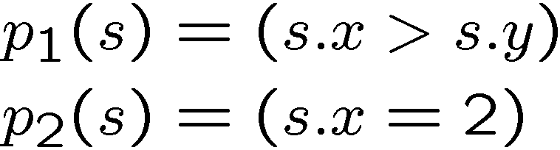
Predicate Abstraction
New Predicates:
✓

Slide 55
Predicate Abstraction for Software
Let’s take existential abstraction seriously
Basic idea: with n predicates, there are 2^{n} x 2^{n} possible abstract transitions
Let’s just check them!

Slide 56
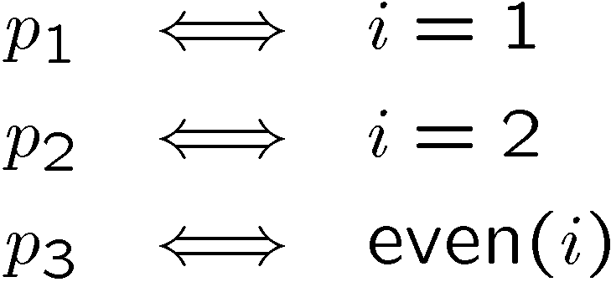

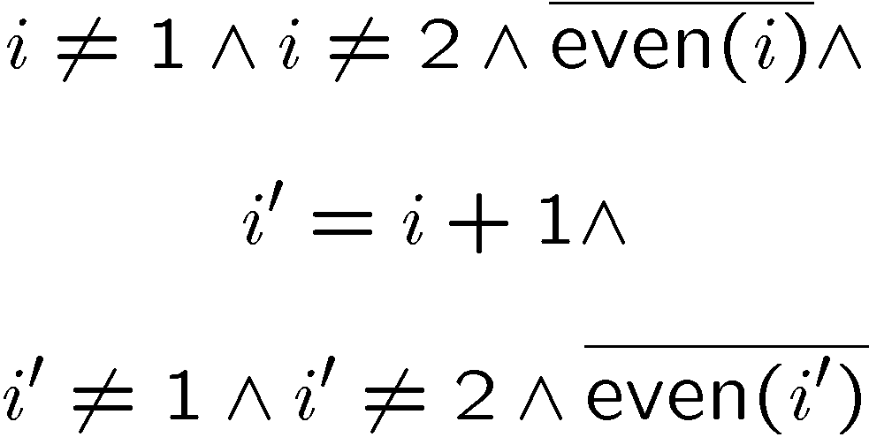
Existential Abstraction
Predicates
Basic Block
Formula
i++;
Query
p₁ | p₂ | p₃
0 | 0 | 0
0 | 0 | 1
0 | 1 | 0
0 | 1 | 1
1 | 0 | 0
1 | 0 | 1
1 | 1 | 0
1 | 1 | 1
✗
p’₁ | p’₂ | p’₃
0 | 0 | 0
0 | 0 | 1
0 | 1 | 0
0 | 1 | 1
1 | 0 | 0
1 | 0 | 1
1 | 1 | 0
1 | 1 | 1
?
Current Abstract State
Next Abstract State

Slide 57
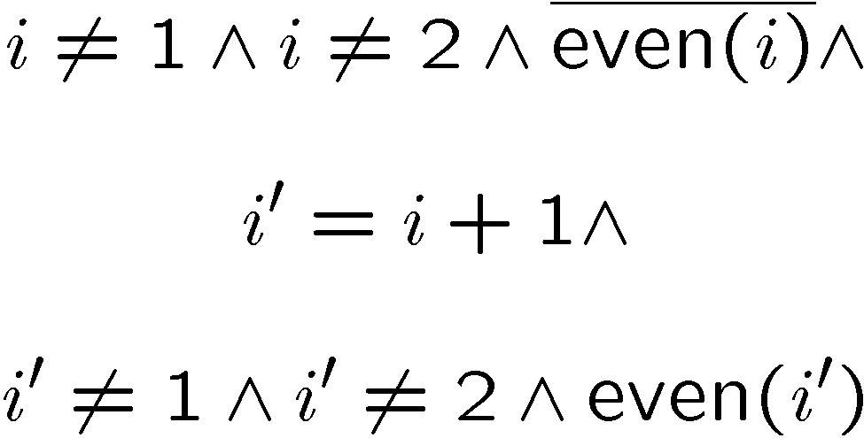
Existential Abstraction
Predicates
Basic Block
Formula
i++;
Query
p₁ | p₂ | p₃
0 | 0 | 0
0 | 0 | 1
0 | 1 | 0
0 | 1 | 1
1 | 0 | 0
1 | 0 | 1
1 | 1 | 0
1 | 1 | 1
p’₁ | p’₂ | p’₃
0 | 0 | 0
0 | 0 | 1
0 | 1 | 0
0 | 1 | 1
1 | 0 | 0
1 | 0 | 1
1 | 1 | 0
1 | 1 | 1
✓
?
… and so on …
Current Abstract State
Next Abstract State

Slide 58
Example for Predicate Abstraction
int main() {
int i;
i=0;
while(even(i))
i++;
}
void main() {
bool p1, p2;
p1=TRUE;
p2=TRUE;
while(p2)
{
p1=p1?FALSE:nondet();
p2=!p2;
}
}
+
p₁ ⇔ i=0
p₂ ⇔ even(i)
=
C program
Predicates
Boolean program
[Graf, Saidi ’97]
[Ball, Rajamani ’00]

Slide 59
Predicate Abstraction for Software
How do we get the predicates?
Automatic abstraction refinement!
[Clarke et al. ’00]
[Kurshan et al. ’93]
[Ball, Rajamani ’00]

Slide 60
Abstraction Refinement Loop
Initial
Abstraction
Verification
Actual
Program
No error
or bug found
Model
Checker
Concurrent
Boolean
Program
Property
holds
Counterexample
Refinement
Simulator
Simulation
successful
Abstraction refinement
Bug found
Spurious counterexample

Slide 61
SLAM
Tool to automatically check device drivers for certain errors
  Takes as input Boolean programs
Used as a Device Driver Development Kit
Full detail (and all the slides) available at http://research.microsoft.com/slam/

Slide 62

Abstraction Refinement Loop
Initial
Abstraction
Verification
Actual
Program
No error
or bug found
Model
Checker
Concurrent
Boolean
Program
Property
holds
Refinement
Simulator
Simulation
successful
Abstraction refinement
Bug found
Spurious counterexample

Slide 63
Problems with Existing Tools
Existing tools (BLAST, SLAM, MAGIC) use a Theorem Prover like Simplify
Theorem prover works on real or natural numbers, but C uses bit-vectors ➔ false positives
Most theorem provers support only few operators
(+, -, <, ≤, …), no bitwise operators
Idea: Use SAT solver to do bit-vector! - SATABS

Slide 64
Abstraction with SAT - SATABS
Successfully used for abstraction of C programs (Clarke, Kroening, Sharygina, Yorav ’03 – SAT-based predicate abstraction)
There is now a version of SLAM that has it
  Found previously unknown Windows bug
Create a SAT instance which relates initial value of predicates, basic block, and the values of predicates after the execution of basic block
SAT also used for simulation and refinement

Slide 65
Our Solution
Use SAT solver!
Generate query equation with
predicates as free variables
Transform equation into CNF using Bit Vector Logic
One satisfying assignment matches one abstract transition
Obtain all satisfying assignments
= most precise abstract transition relation
This solves two problems:
Now can do all ANSI-C integer operators, including *, /, %, <<, etc.
Sound with respect to overflow
No more
unnecessary spurious counterexamples!

Slide 66
Abstraction Refinement Loop
Initial
Abstraction
Verification
Actual
Program
No error
or bug found
Model
Checker
Concurrent
Boolean
Program
Property
holds
Refinement
Simulator
Simulation
successful
Abstraction refinement
Bug found
Spurious counterexample

Slide 67
Model Checkers for Boolean Programs
Explicit State
  Zing
  SPIN
Symbolic
  Moped
  Bebop
  SMV

Slide 68
Abstraction Refinement Loop
Initial
Abstraction
Verification
Actual
Program
No error
or bug found
Model
Checker
Concurrent
Boolean
Program
Property
holds
Refinement
Simulator
Simulation
successful
Abstraction refinement
Bug found
Spurious counterexample

Slide 69
Refinement
Need to distinguish two sources of spurious behavior
  Too few predicates
  Laziness during abstraction
SLAM:
  First tries to find new predicates (NEWTON) using weakest preconditions
  If this fails, second case is assumed.
  Transitions are refined (CONSTRAIN)
Refine transitions using UNSAT cores (Clarke, Kroening, Sharygina, Yorav’05)

Slide 70
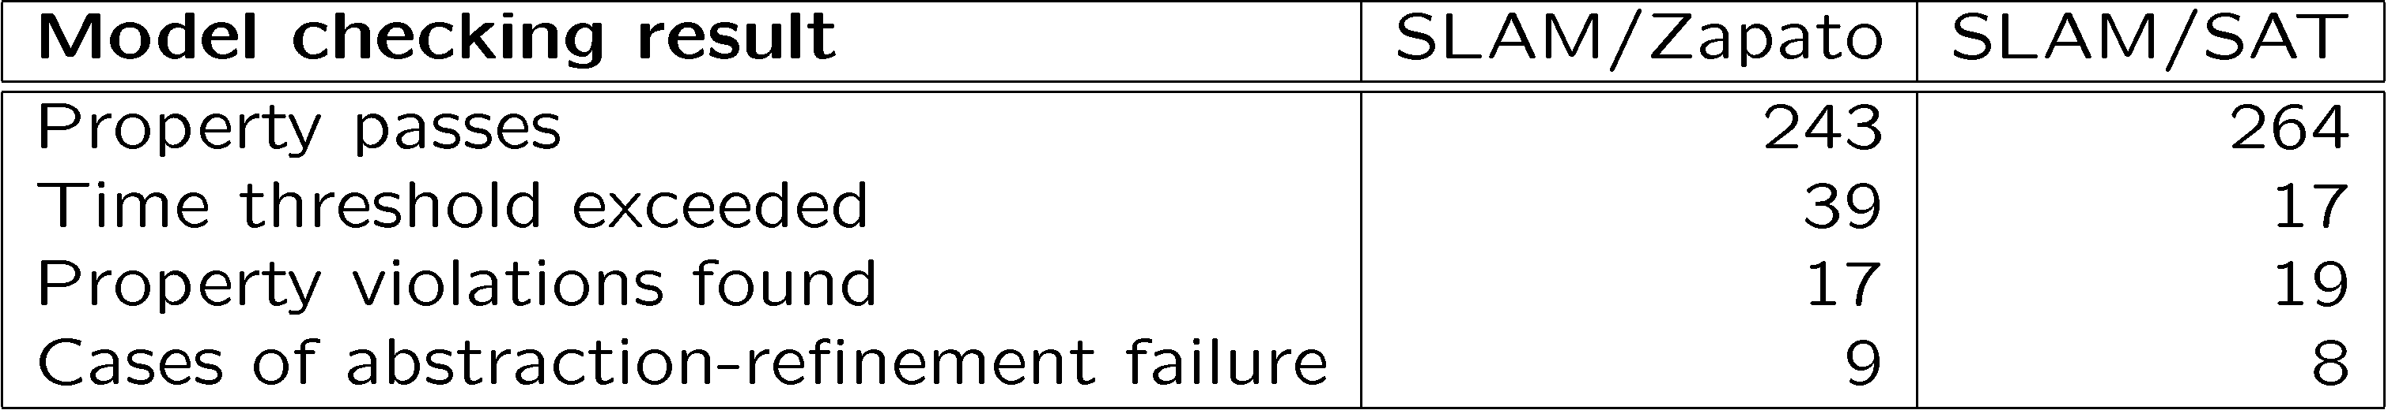
Experimental Results
Comparison of SLAM with Integer-based theorem prover against SAT-based SLAM
308 device drivers
Timeout: 1200s

Slide 71
SATABS lab: Thursday, 5 p.m.

